Slide 1
Congestion Control Algorithms
Congestion in a computer network happens when there is too much data being sent at the same time, causing the network to slow down.
Just like traffic congestion on a busy road, network congestion leads to delays and sometimes data loss. When the network can’t handle all the incoming data, it gets “clogged,” making it difficult for information to travel smoothly from one place to another.
It refers to the methods used to prevent network overload and ensure smooth data flow. When too much data is sent through the network at once, it can cause delays and data loss.
Congestion control techniques help manage the traffic, so all users can enjoy a stable and efficient network connection. These techniques are essential for maintaining the performance and reliability of modern networks.
Congestion occurs within the network, it is the network layer that directly experiences it and must ultimately determine what to do with the excess packets.
However, the most effective way to control congestion is to reduce the load that the transport layer is placing on the network. This requires the network and transport layers to work together.
500

Slide 2
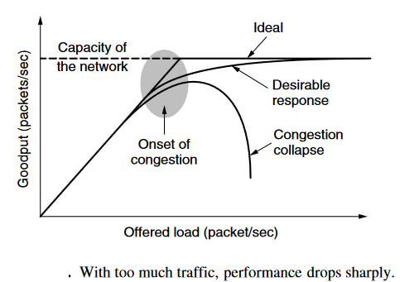
Congestion Control Algorithms
500
When the number of packets hosts send into the network is well within its carrying capacity, the number delivered is proportional to the number sent.
If twice as many are sent, twice as many are delivered. However, as the offered load approaches the carrying capacity, bursts of traffic occasionally fill up the buffers inside routers and some packets are lost.
These lost packets consume some of the capacity, so the number of delivered packets falls below the ideal curve. The network is now congested.

Slide 3
Congestion Control Algorithms
Unless the network is well designed, it may experience a congestion collapse, in which performance plummets as the offered load increases beyond the capacity.
This can happen because packets can be sufficiently delayed inside the network that they are no longer useful when they leave the network.
For example, in the early Internet, the time a packet spent waiting for a backlog of packets ahead of it to be sent over a slow 56-kbps link could reach the maximum time it was allowed to remain in the network.
It then had to be thrown away. A different failure mode occurs when senders retransmit packets that are greatly delayed, thinking that they have been lost.
In this case, copies of the same packet will be delivered by the network, again wasting its capacity. To capture these factors, the y-axis of figure is given as goodput, which is the rate at which useful packets are delivered by the network.
500

Slide 4
Congestion Control Algorithms
Low-bandwidth links or routers that process packets more slowly than the line rate can also become congested.
In this case, the situation can be improved by directing some of the traffic away from the bottleneck to other parts of the network.
Eventually, however, all regions of the network will be congested. In this situation, there is no alternative but to shed load or build a faster network.
Flow control, in contrast, relates to the traffic between a particular sender and a particular receiver. Its job is to make sure that a fast sender cannot continually transmit data faster than the receiver is able to absorb it.
A network made up of 100-Gbps fiber optic links on which a supercomputer is trying to force feed a large file to a personal computer that is capable of handling only 1 Gbps.
Consider a network with 1-Mbps lines and 1000 large computers, half of which are trying to transfer files at 100 kbps to the other half. Here, the problem is not that of fast senders overpowering slow receivers, but that the total offered traffic exceeds what the network can handle.
500

Slide 5
Effects of Congestion in Computer Network
Improved Network Stability: Congestion control helps keep the network stable by preventing it from getting overloaded. It manages the flow of data so the network doesn’t crash or fail due to too much traffic.
Reduced Latency and Packet Loss: Without congestion control, data transmission can slow down, causing delays and data loss. It helps manage traffic better, reducing these delays and ensuring fewer data packets are lost, making data transfer faster and the network more responsive.
Enhanced Throughput: By avoiding congestion, the network can use its resources more effectively. This means more data can be sent in a shorter time, which is important for handling large amounts of data and supporting high-speed applications.
Fairness in Resource Allocation: Congestion control ensures that network resources are shared fairly among users. No single user or application can take up all the bandwidth allowing everyone to have a fair share.
Better User Experience: When data flows smoothly and quickly, users have a better experience. Websites, online services, and applications work more reliably and without annoying delays.
Mitigation of Network Congestion Collapse: Without congestion control, a sudden spike in data traffic can overwhelm the network, causing severe congestion and making it almost unusable. Congestion control helps prevent this by managing traffic efficiently and avoiding such critical breakdowns.
500

Slide 6
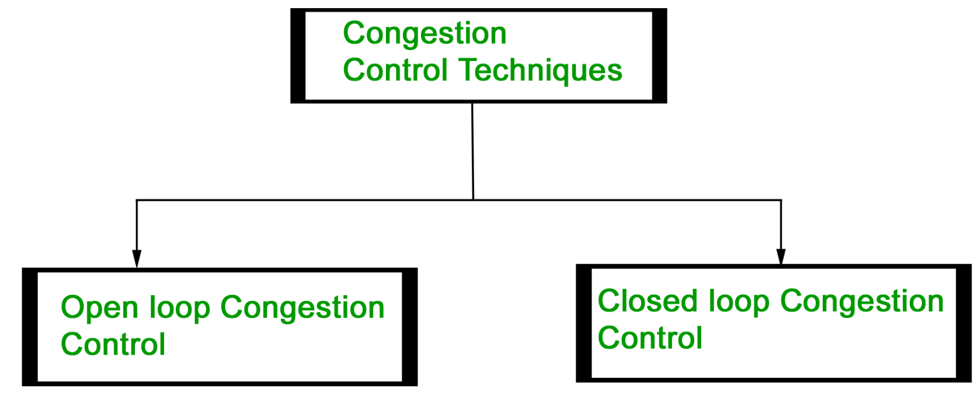
General Principles of Congestion Control
Congestion control refers to the techniques used to control or prevent congestion. Congestion control techniques can be broadly classified into two categories:
500

Slide 7
Open Loop Congestion Control Techniques
Open Loop Congestion Control
Open loop congestion control policies are applied to prevent congestion before it happens. The congestion control is handled either by the source or the destination.
Policies adopted by open loop congestion control :
Retransmission Policy : It is the policy in which retransmission of the packets are taken care of. If the sender feels that a sent packet is lost or corrupted, the packet needs to be retransmitted. This transmission may increase the congestion in the network.
To prevent congestion, retransmission timers must be designed to prevent congestion and also able to optimize efficiency.
Window Policy : The type of window at the sender’s side may also affect the congestion. Several packets in the Go-back-n window are re-sent, although some packets may be received successfully at the receiver side.
This duplication may increase the congestion in the network and make it worse. Therefore, Selective repeat window should be adopted as it sends the specific packet that may have been lost.
500

Slide 8
Open Loop Congestion Control Techniques
Discarding Policy :
A good discarding policy adopted by the routers is that the routers may prevent congestion and at the same time partially discard the corrupted or less sensitive packages and also be able to maintain the quality of a message. In case of audio file transmission, routers can discard less sensitive packets to prevent congestion and also maintain the quality of the audio file.
Acknowledgment Policy :
Since acknowledgements are also the part of the load in the network, the acknowledgment policy imposed by the receiver may also affect congestion. Several approaches can be used to prevent congestion related to acknowledgment. The receiver should send acknowledgement for N packets rather than sending acknowledgement for a single packet. The receiver should send an acknowledgment only if it has to send a packet or a timer expires. Admission Policy :
In admission policy a mechanism should be used to prevent congestion. Switches in a flow should first check the resource requirement of a network flow before transmitting it further. If there is a chance of a congestion or there is a congestion in the network, router should deny establishing a virtual network connection to prevent further congestion.
500

Slide 9
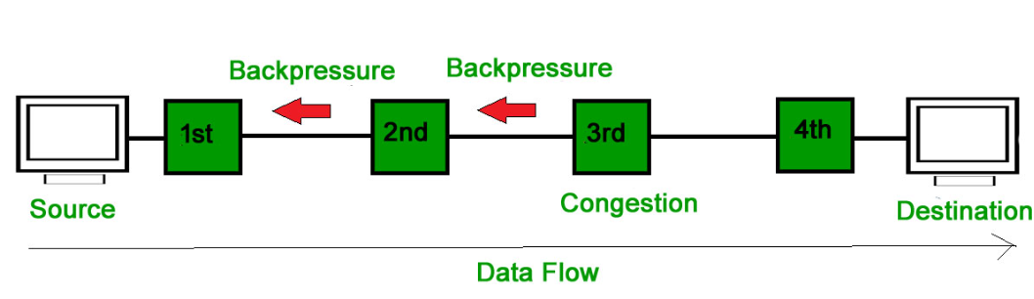
Closed Loop Congestion Control Techniques
Closed Loop Congestion Control
Closed loop congestion control techniques are used to treat or alleviate congestion after it happens. Several techniques are used by different protocols; some of them are:
Backpressure :
Backpressure is a technique in which a congested node stops receiving packets from upstream node. This may cause the upstream node or nodes to become congested and reject receiving data from above nodes. Backpressure is a node-to-node congestion control technique that propagate in the opposite direction of data flow. The backpressure technique can be applied only to virtual circuit where each node has information of its above upstream node.
500

Slide 10
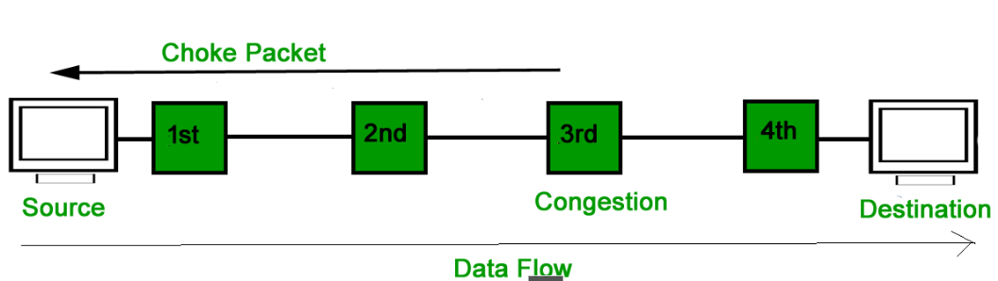
Closed Loop Congestion Control Techniques
Choke Packet Technique :
Choke packet technique is applicable to both virtual networks as well as datagram subnets. A choke packet is a packet sent by a node to the source to inform it of congestion. Each router monitors its resources and the utilization at each of its output lines. Whenever the resource utilization exceeds the threshold value which is set by the administrator, the router directly sends a choke packet to the source giving it a feedback to reduce the traffic. The intermediate nodes through which the packets has traveled are not warned about congestion.

Slide 11
Closed Loop Congestion Control Techniques
Implicit..Signaling
In implicit signaling, there is no communication between the congested nodes and the source. The source guesses that there is congestion in a network. For example when sender sends several packets and there is no acknowledgment for a while, one assumption is that there is a congestion.
Explicit..Signaling
In explicit signaling, if a node experiences congestion it can explicitly sends a packet to the source or destination to inform about congestion. The difference between choke packet and explicit signaling is that the signal is included in the packets that carry data rather than creating a different packet as in case of choke..packet…technique. Explicit signaling can occur in either forward or backward direction.
Forward Signaling : In forward signaling, a signal is sent in the direction of the congestion. The destination is warned about congestion. The receiver in this case adopt policies to prevent further congestion.
Backward Signaling : In backward signaling, a signal is sent in the opposite direction of the congestion. The source is warned about congestion and it needs to slow down.
500

Slide 12
Closed Loop Congestion Control Techniques
500
Basis of Difference | Open Loop Congestion System | Closed Loop Congestion System
Definition | A control system in which there is no feedback path is provided is called an open loop control system. | The control system in which there is a feedback path present is called a closed loop control system.
Also called | Open loop control system is also called non-feedback control system. | Closed loop control system is also called a feedback control system.
Control action | In open loop control system, the control action is independent of the output of the overall system. | In closed loop control system, the control action is dependent on the output of the system.
Design complexity | The design and construction of an open loop control system is quite simple. | Closed loop control system has comparatively complex design and construction.
Main Components | The major components of an open loop control system are − controller and plant. | The main components of a closed loop control system are − Controller, plant or process, feedback element and error detector (comparator).

Slide 13
Closed Loop Congestion Control Techniques
Basis of Difference | Open Loop Congestion System | Closed Loop Congestion System
Reliability | The reliability of open loop control system is less. | The closed loop control system is more reliable.
Accuracy | The accuracy of open loop control system depends upon the system calibration and therefore, may be less. | Closed loop control system is comparatively accurate because the feedback maintains its accuracy.
Stability (in terms of output) | The stability of open loop control system is more, i.e., the output of the open loop system remains constant. | Closed loop control system is comparatively less stable.
Optimization | The open loop control system is not optimized. | Closed loop control system is optimized to produce the desired output.
Maintenance | Open loop control system requires less maintenance. | Comparatively more maintenance is needed in closed loop control system.
Implementation | Open loop control system is easy to implement. | The implementation of a closed loop control system is relatively difficult.
500

Slide 14
Closed Loop Congestion Control Techniques
Basis of Difference | Open Loop Control System | Closed Loop Control System
Cost | Open loop control system is less expensive. | The cost of the closed loop control system is relatively high.
Noise | Open loop control system has more internal noise. | In closed loop system, the internal noise in the system is less.
Examples | Common practical examples of open loop control systems are − automatic traffic light system, automatic washing machine, immersion heater, etc. | Examples of closed loop control systems include: ACs, fridge, toaster, rocket launching system, radar tracking system, etc.
500

Slide 15
Congestion Prevention Policies
Layer | Policies
Transport | Retransmission | It deals with how fast a sender times out and what it transmits upon timeout. A jumpy sender that times out quickly and retransmits all outstanding packets using go back n / selective repeat.
 | Out-of-order caching Policy | If receivers routinely discard all out-of-order packets, these packets will have to be transmitted again later , creating extra load wrt congestion control, selective repeat and go back n.
 | Acknowledgement policy | If each packet is acknowledged immediately, then acknowledgement packets generate extra traffic. If acknowledgements are saved up piggyback onto reverse traffic, extra timeouts and retransmission may result to congestion.
 | Flow Control Policy | A small window reduces the data rate and thus helps fight congestion.
 | Timeout determination | If time out interval too short, extra packets will be sent unnecessarily. If its too long, congestion will be reduced but the response time will suffer whenever a packet is lost.
500

Slide 16
Congestion Prevention Policies
Layer | Policies
Network | Virtual circuits Vs Datagram Inside the circuit | The choice between using virtual circuits and datagram circuits affects congestion. Many congestion control algorithms works only with VC subnets.
 | Packet Queuing and service policy | This relates to whether routers have one queue per input line, one queue output line or both. It also relates to the order in which packets are processed. (Round Robin, Priority)
 | Packet discard policy | The rule telling which packet is dropped when there is no space.
 | Routing algorithm | It can help avoid congestion by spreading the traffic over all lines. Whereas a bad one can send too much traffic over already congested lines.
 | Packet lifetime management | It deals with how long a packet may live before being discarded. If its too long, lost packets may clog up the works for a long time. If its too short, packets may sometimes time out before reaching their destination, thus inducing retransmissions.
500

Slide 17
Congestion Prevention Policies
Layer | Policies
Data Link | Retransmission Policy | It deals with how fast a sender times out and what it transmits upon timeout. A jumpy sender that times out quickly and retransmits all outstanding packets using go back n / selective repeat.
 | Out-of-order-policy | If receivers routinely discard all out-of-order packets, these packets will have to be transmitted again later , creating extra load wrt congestion control, selective repeat and go back n.
 | Acknowledgement Policy | If each packet is acknowledged immediately, then acknowledgement packets generate extra traffic. If acknowledgements are saved up piggyback onto reverse traffic, extra timeouts and retransmission may result to congestion.
 | Flow Control Policy | A small window reduces the data rate and thus helps fight congestion.
 |  | Similar to Transport Layer
500

